Slide 1
Measuring biodiversity
Roel van Klink
Roel.klink@idiv.de

Slide 2
Learning objectives
At the end of today you will have:
Learned how to describe different facets of biodiversity
Learned how to calculate and interpret these metrics

Slide 3
What is biodiversity?
UN definition:

Slide 4
Major Ecological Gradients
Latitude
Elevation
Energy/Productivity
Heterogeneity
Disturbance
Island size/Habitat Loss
Biogeography, other factors

Slide 5
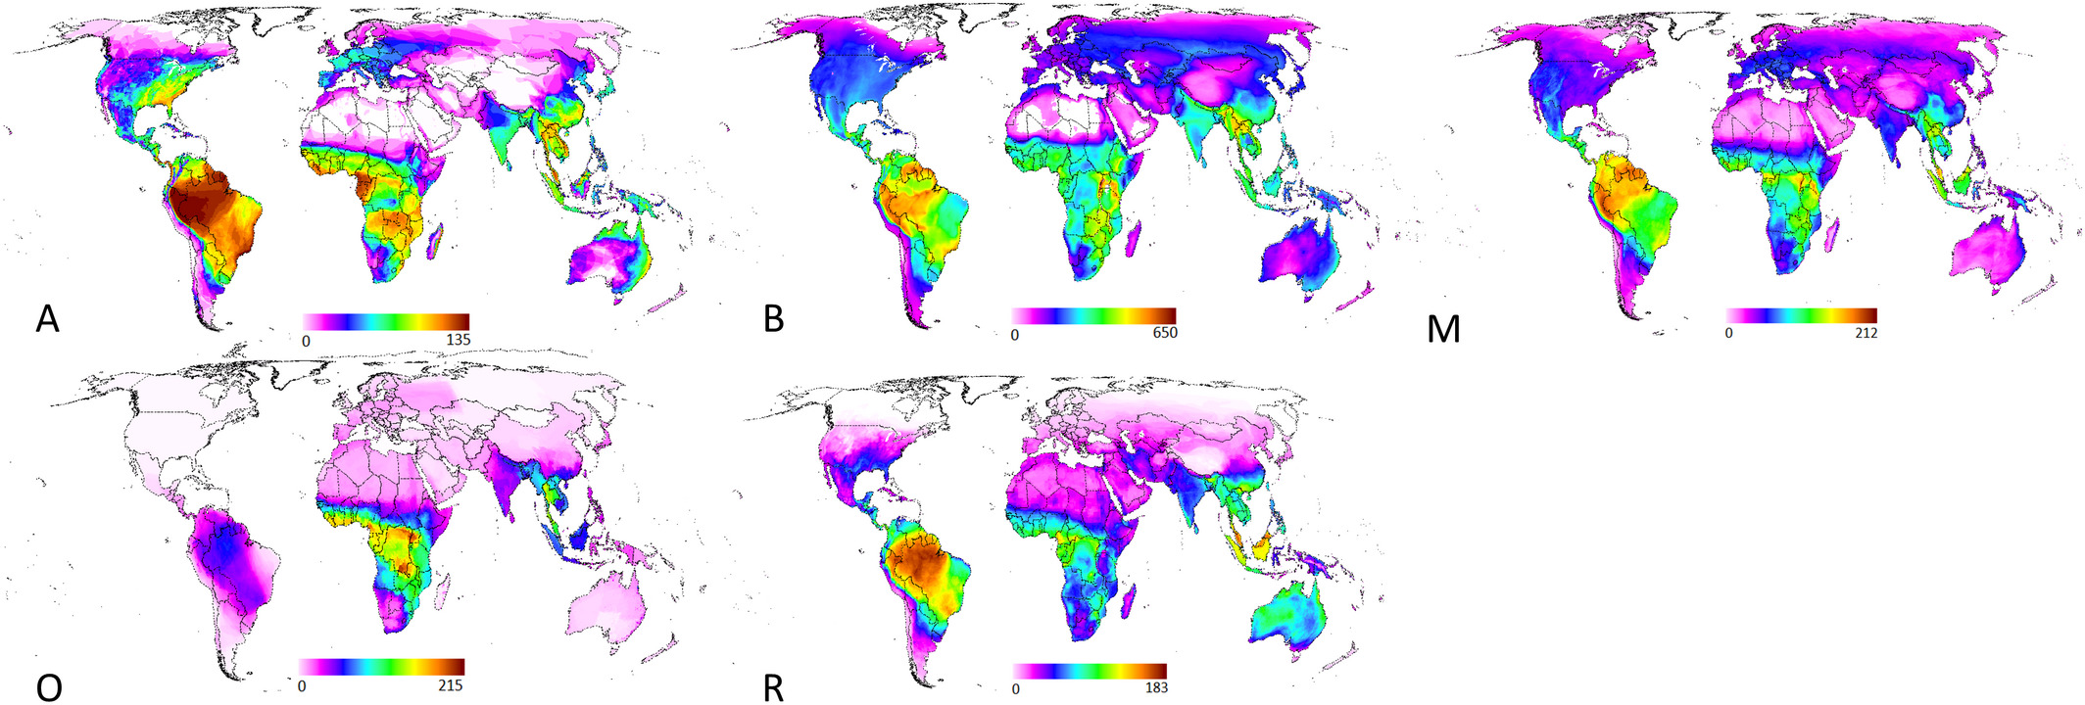
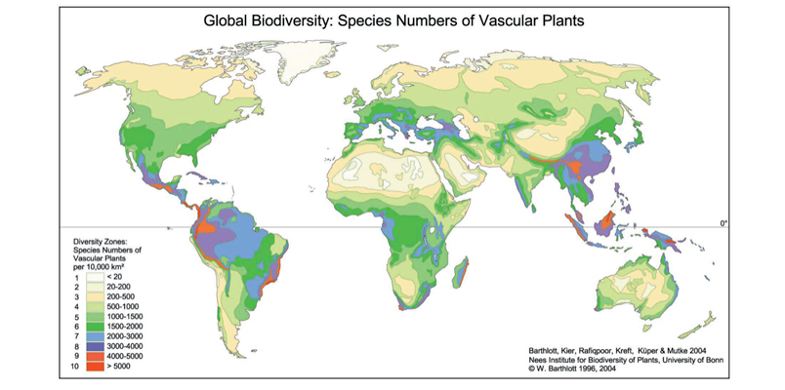
Where is biodiversity?
Amphibien
Voegel
Saeuger
Libellen
Reptilien
Pflanzen
Global Ecology and Biogeography, Volume: 30, Issue: 7, Pages: 1375-1388, First published: 22 April 2021, DOI: (10.1111/geb.13304)

Slide 6
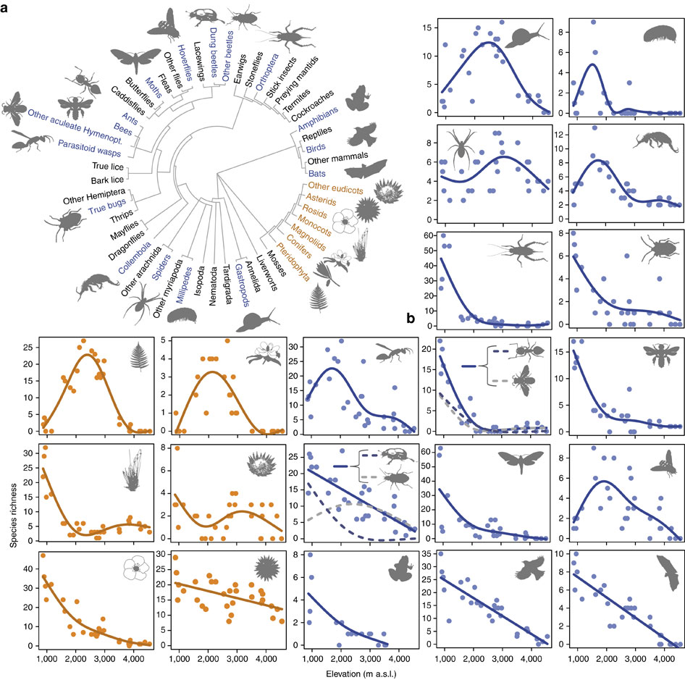
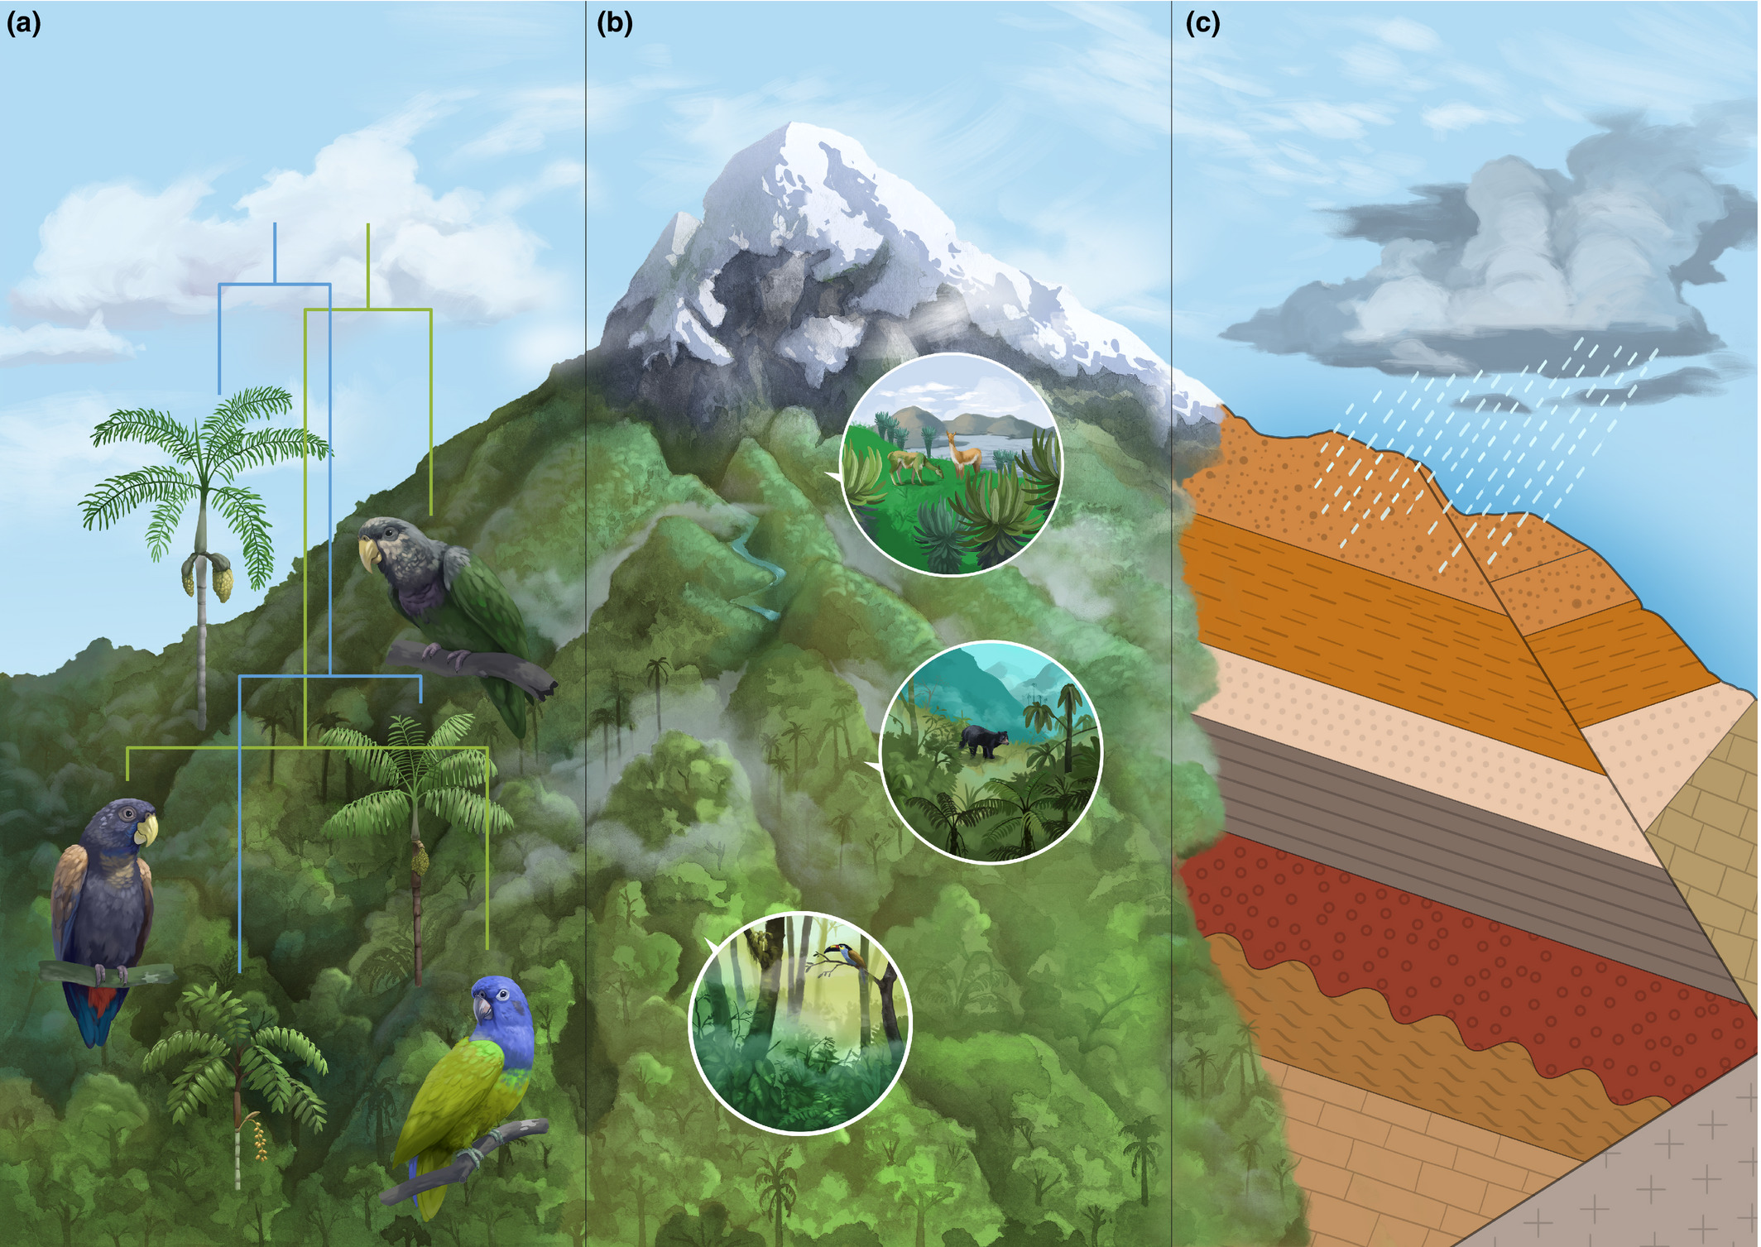
Where is biodiversity?

Slide 7
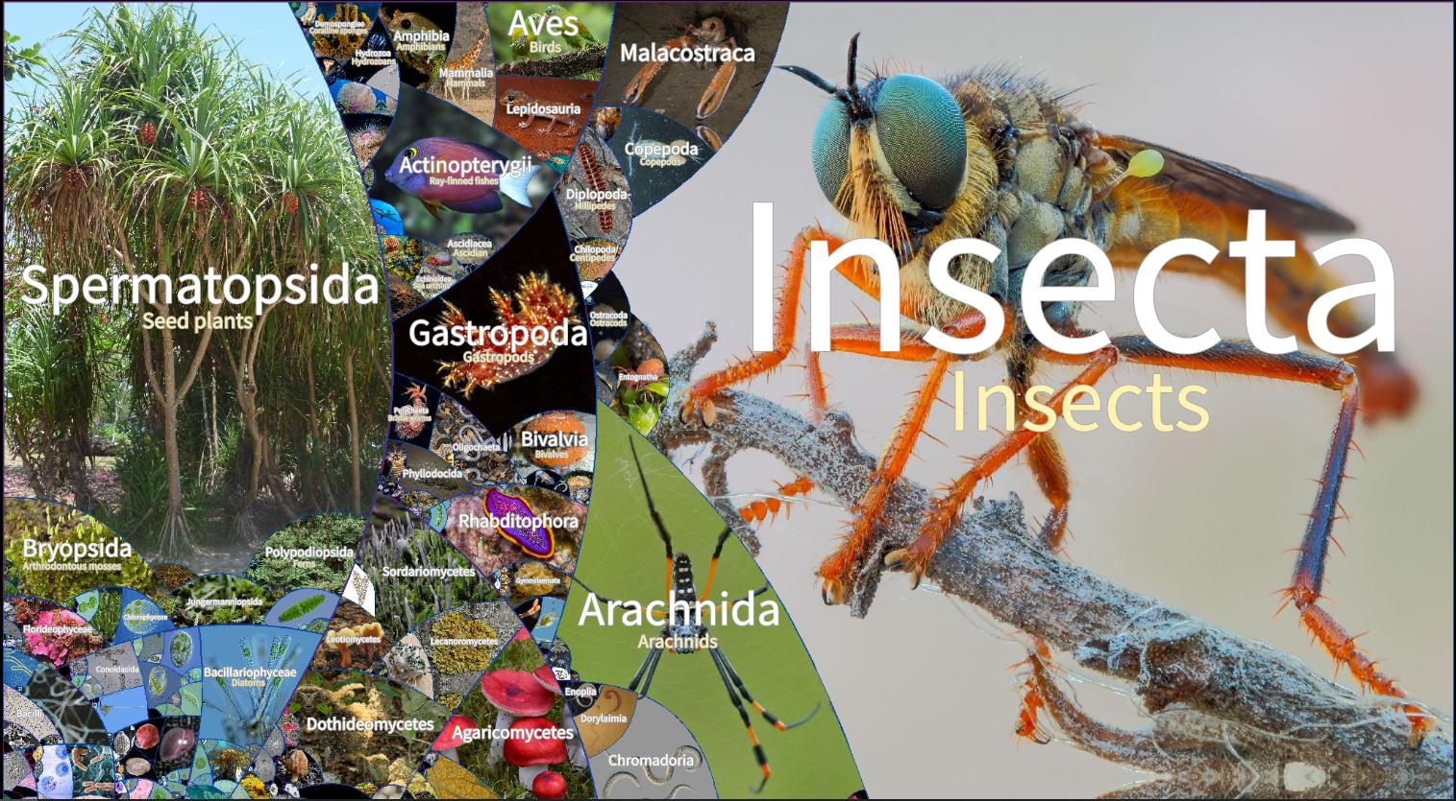
Some numbers
Freiberg, M., Reichert, M. (2021). LifeGate. An interactive phylogenetic map. https://lifegate.idiv.de/

Slide 8
How many species in Germany and the world?
Artengruppe |  | Artenzahl in Deutschland | Artenzahl weltweit
Wirbeltiere
Säugetiere | Mammalia | 104 | ≈ 5.513
Vögel | Aves | 328 | ≈ 10.425
Kriechtiere | Reptilia | 13 | ≈ 10.038
Lurche | Amphibia | 22 | > 7.302
Wirbellose
Insekten | Hexapoda | > 33.305 | > 1.000.000
Spinnentiere | Chelicerata | > 3.783 | > 102.248
Weichtiere | Mollusca | 635 | > 85.000
Tiere Gesamt |  | > 48.000 | > 1.380.000
Pflanzen
Samenpflanzen | Spermatophyta | 2.988 | ≈ 270.000
Moose | Bryophyta | 1.053 | ≈ 16.000
Pflanzen Gesamt |  | > 9.500 | > 330.000
These are only the DESCRIBED species. ~80% of species are unknown to science.

Slide 9
Exercise
What is needed to compare the biodiversity of different locations or time points?
(If we take 2 samples from the environment, how can we make sure that there is a fair comparison?)

Slide 10
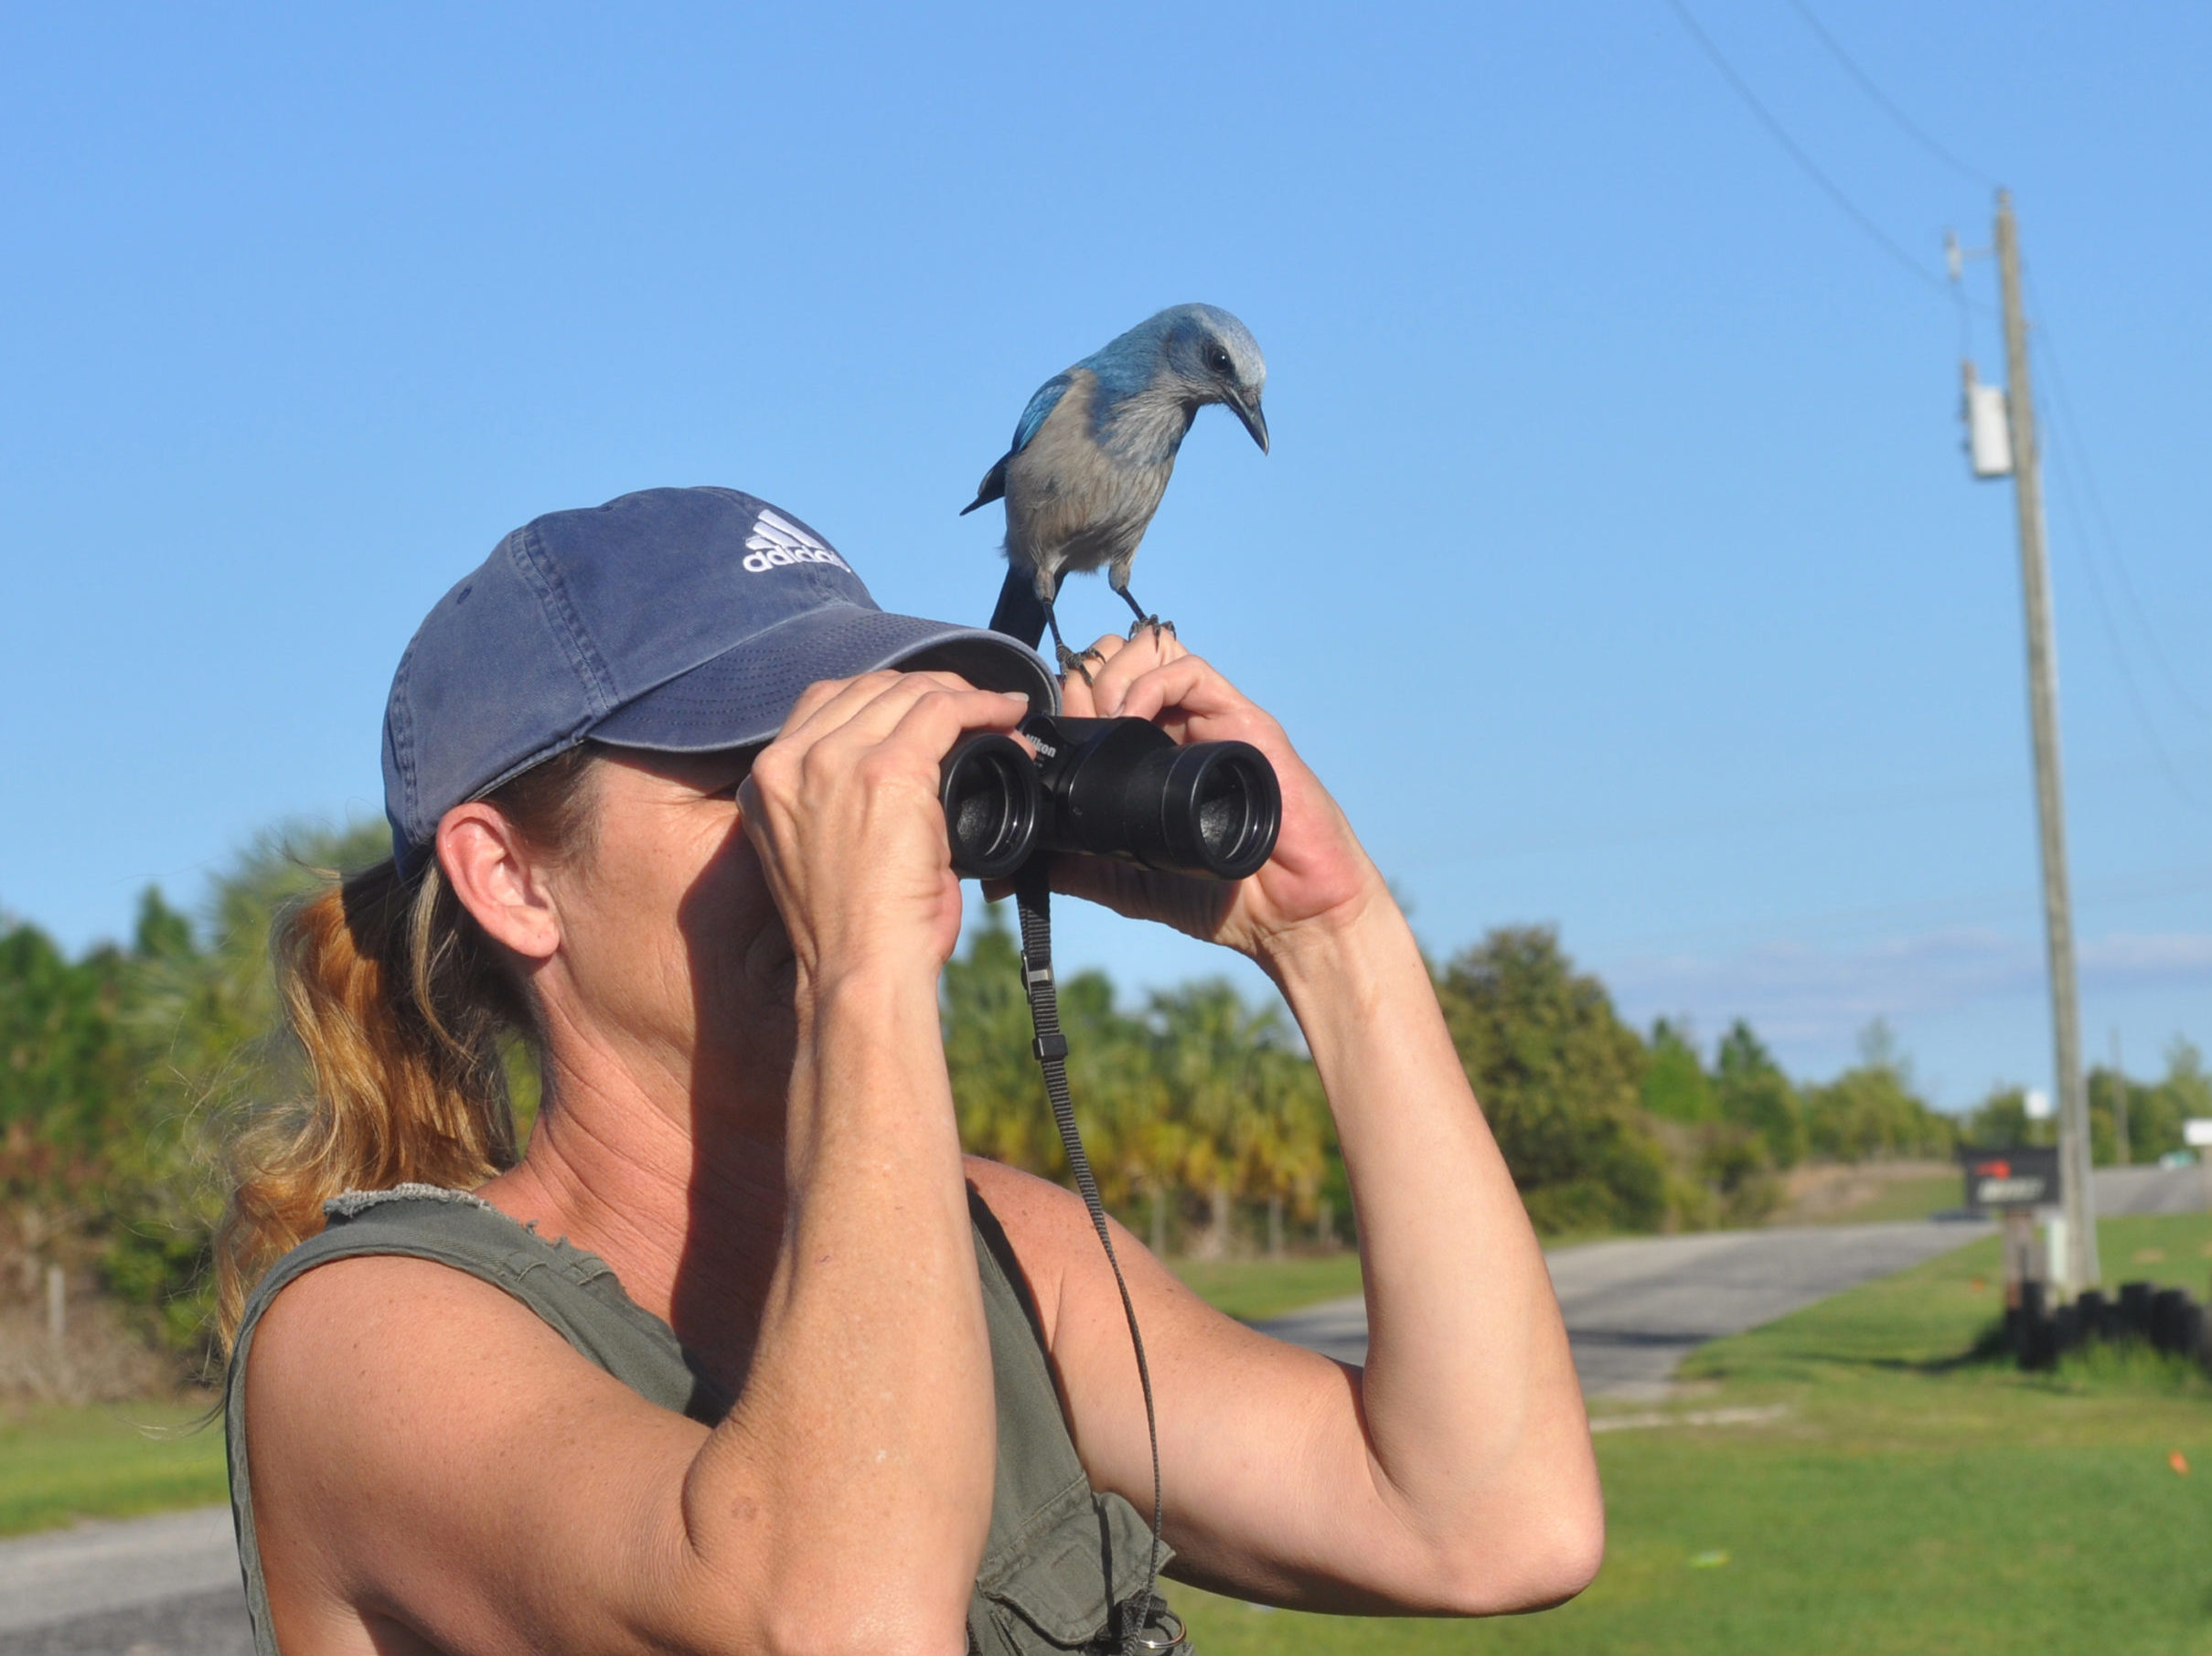
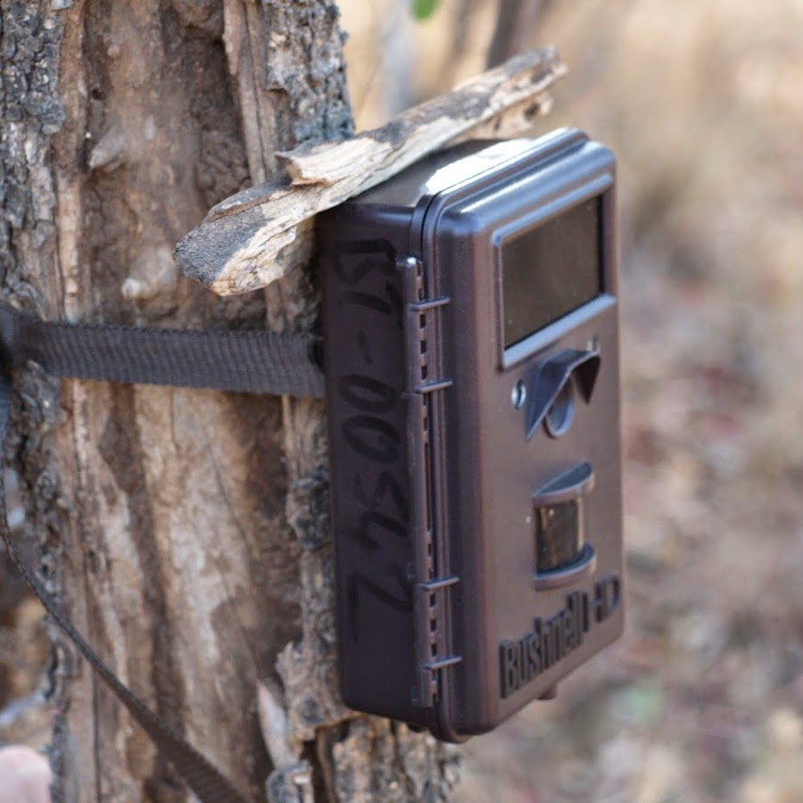
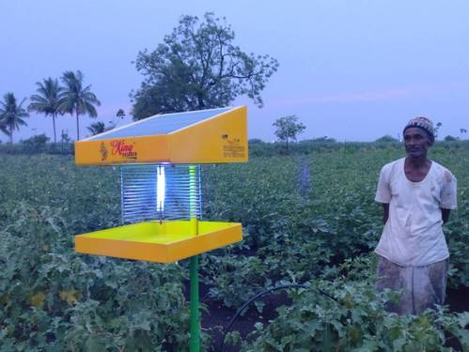
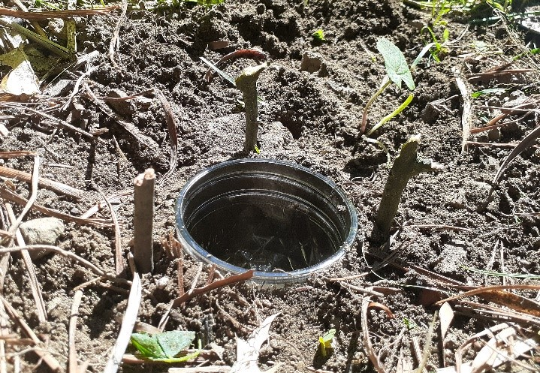
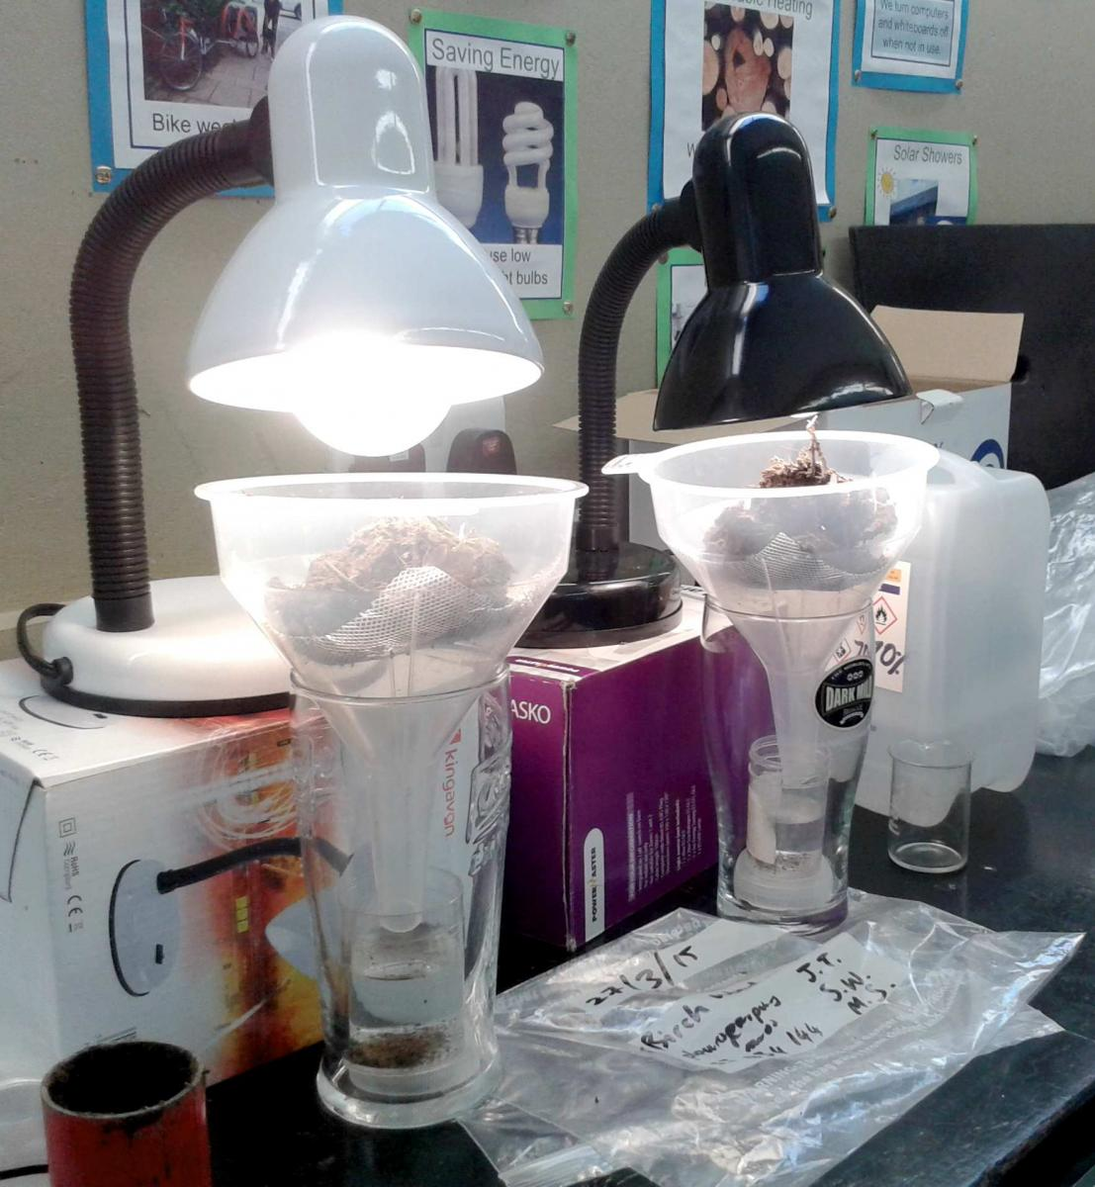
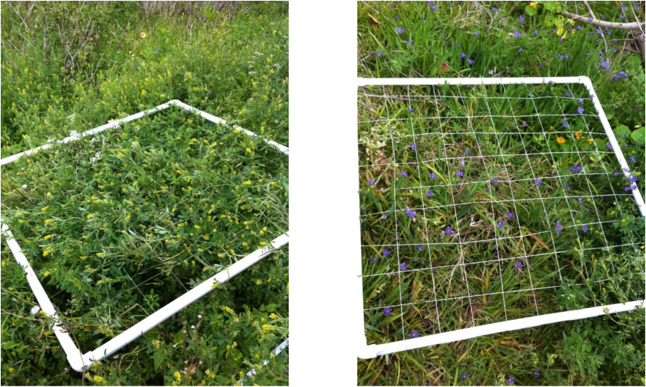
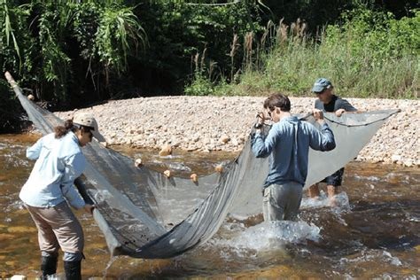
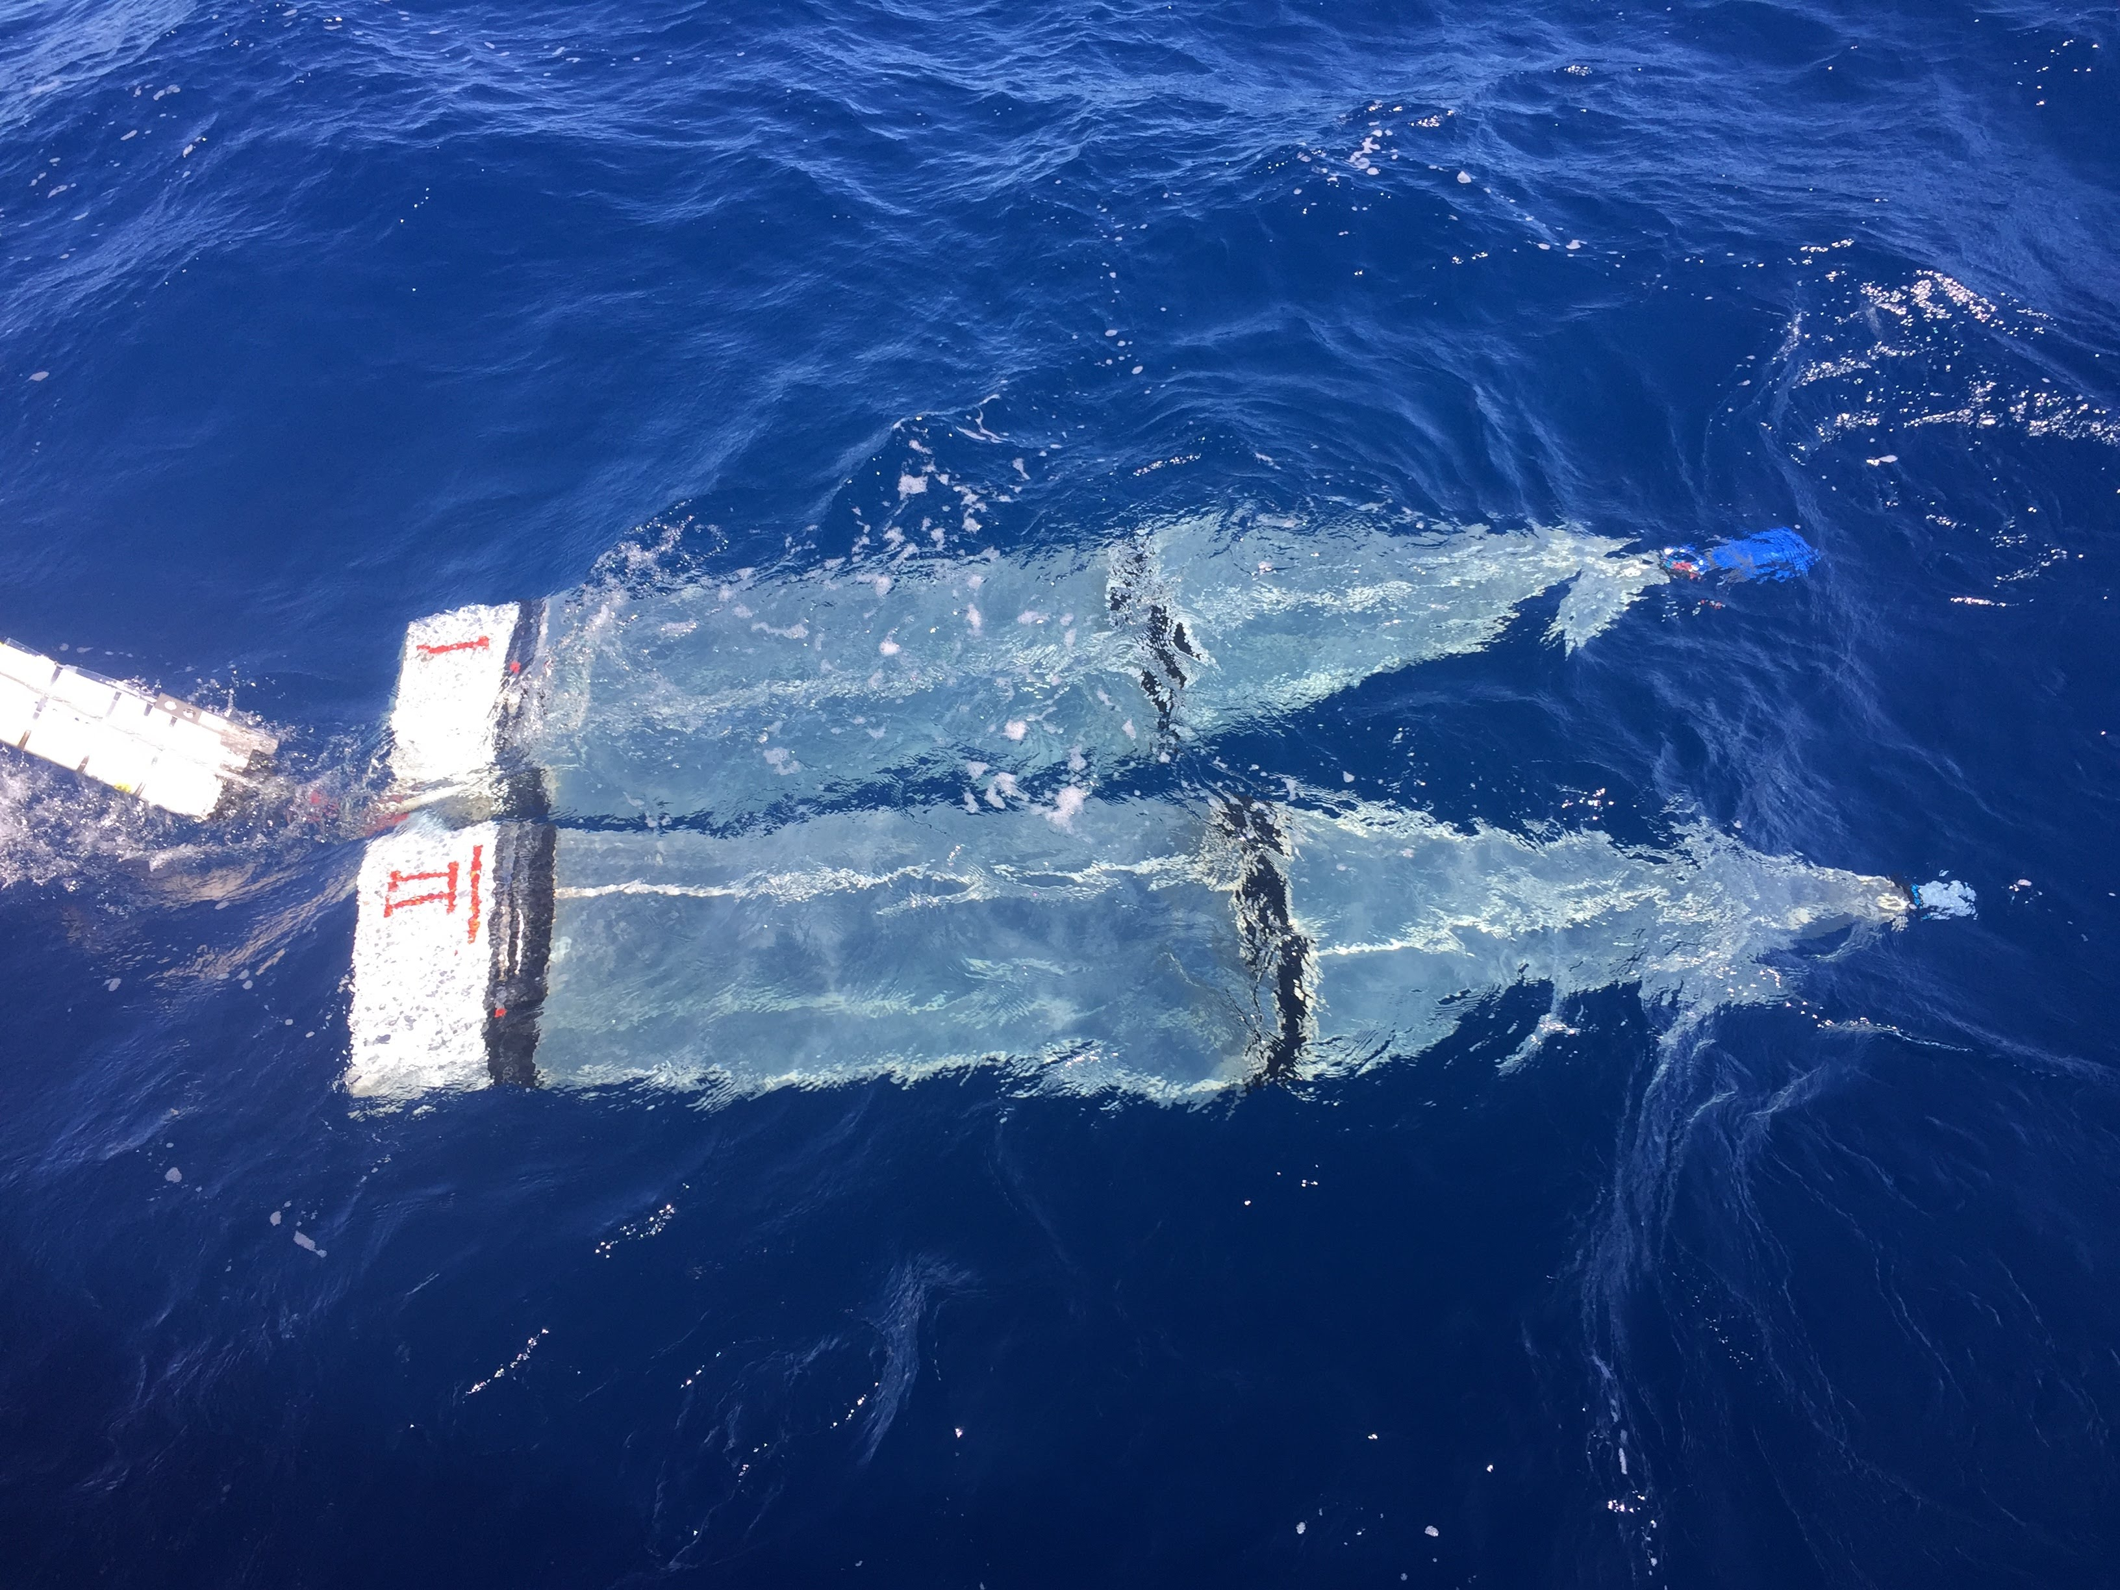
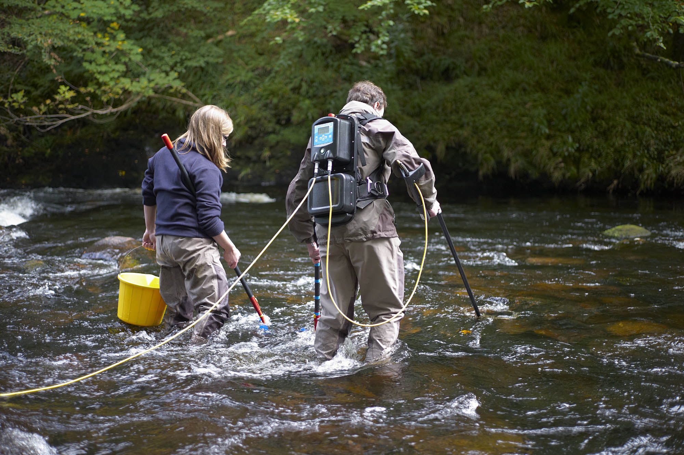
How to sample biodiversity?
Birds: transects
Mammals: camera traps / tracks
Nocturnal insects: light trap
Ground invertebrates: pitfall trap
Below ground fauna: Tullgren extraction
Plants: quadrat
Plankton: tow net
Fish: net / electro fishing

Slide 11
Characteristics of a ‘community’
Most species are rare (observed only once or twice)
Only few species are abundant
Never fewer than 0 observations (no negative numbers)
If you log-transform a well-sampled community, you will approximate a normal distribution (called ‘log-normal’)
Only integers (when using real count data)

Slide 12
-> A vector of species abundances
species1 species2 species3 species4 species5 species6 species7 species8 species9 species10 species11 species12 species13
170 96 49 38 46 38 37 29 23 16 24 21 18
species14 species15 species16 species17 species18 species19 species20 species21 species22 species23 species24 species25 species26
17 24 20 15 14 18 18 16 13 12 15 16 12
species27 species28 species29 species30 species31 species32 species33 species34 species35 species36 species37 species38 species39
17 10 11 11 9 11 9 7 7 5 3 3 4
species40 species41 species42 species43 species44 species45 species46 species47 species48 species49 species50 species51 species52
8 4 3 3 1 2 5 3 4 4 1 1 4
species53 species54 species55 species56 species57 species58 species59 species60 species61 species62 species63 species64 species65
2 1 2 1 2 3 1 1 1 4 2 2 2
species66 species67 species68 species69 species70 species71 species72 species73 species74
1 2 1 1 2 1 1 1 1

Slide 13
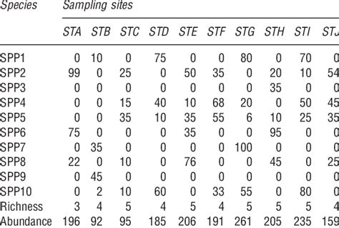
Species by site matrix
CLEARLY FAKE DATA

Slide 14
Exercise
What is needed to compare the biodiversity of different locations or time points?
(If we take 2 samples from the environment, how can we make sure that there is a fair comparison?)
How can we compare biodiversity numerically? (find biodiversity metrics online, and r-packages that can calculate them)
Open file ‘measuring biodiversity.r’

Slide 15
Diversity indices (selection)
Species richness (S)
Number of individuals (N)
Rarefied species richness
Coverage-based richness
Shannon-Wiener index (H’) – should be converted to effective number of species
Simpson index (D) / Probability of interspecific encounter – also convert to effective number of species
Berger Parker dominance (proportional abundance of most abundant species)
McNaughton dominance (proportion of 2 most abundant species)
Fisher’s alpha
Evenness
…

Slide 16
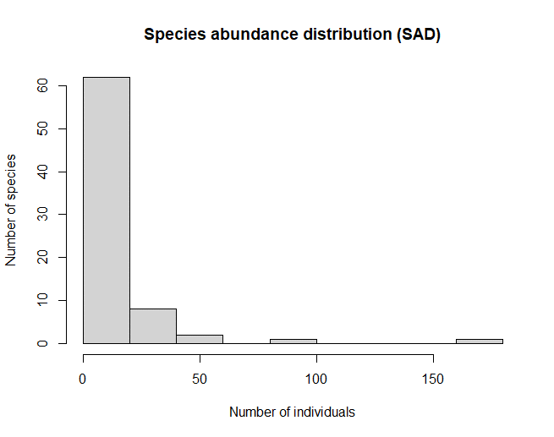
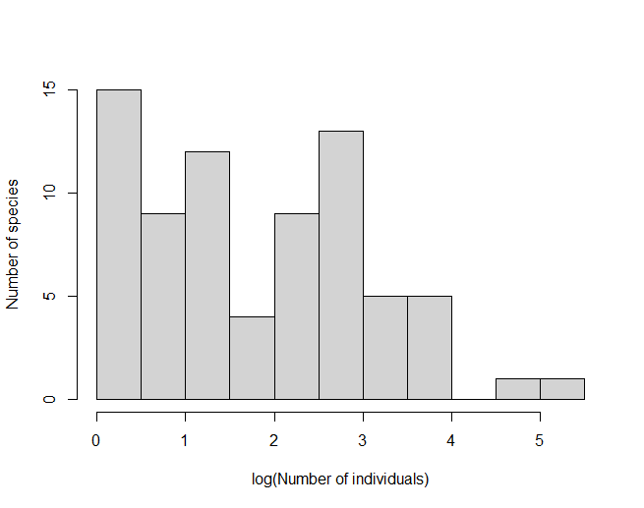
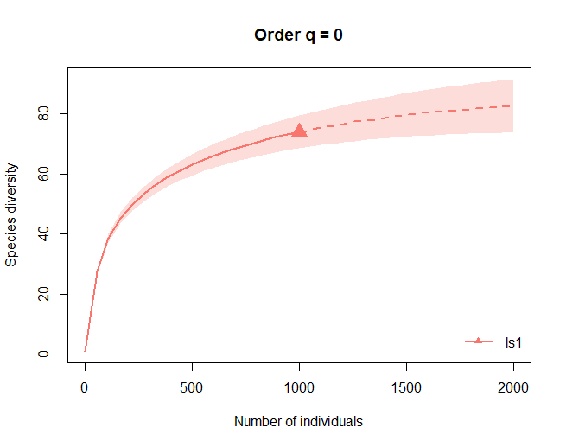
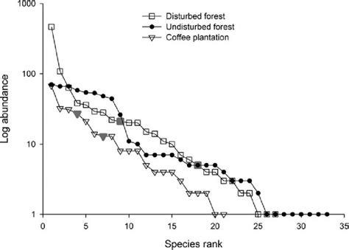
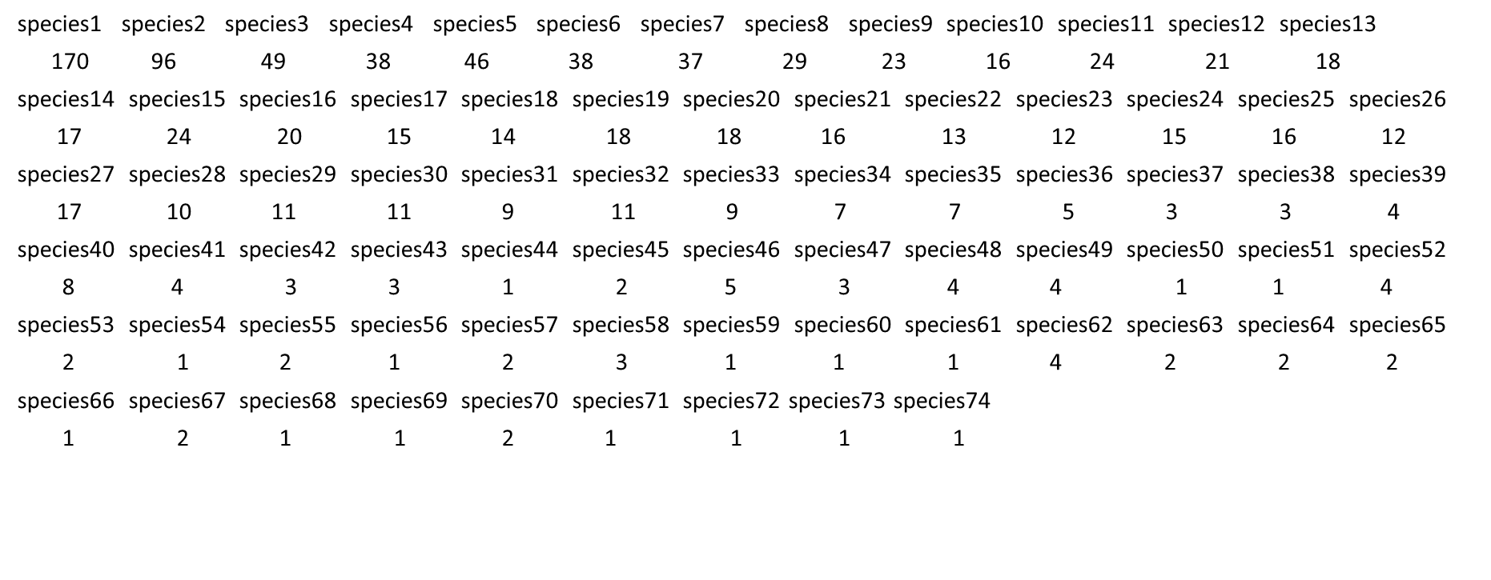
Visualizing the shape of the community
Species abundance distribution (SAD)
Species accumulation curve (SAC)
=>
Rank-abundance distribution
Total # individuals (n) (over all species)

Slide 17
What do these diversity metrics mean?
Shannon Diversity
(sometimes referred to as Shannon-Wiener, or, wrongly, the Shannon-Weaver index):
H
‘Entropy’
Reflects the uncertainty in predicting species’ identity in the sample
H = -Σp_{i} * ln(p_{i})
where:
Σ: A Greek symbol that means “sum”
ln: Natural log
p_{i}: The proportion of the entire community made up of species i

Slide 18
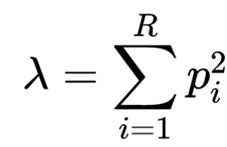
What do these diversity metrics mean?
Simpson Diversity
D
Reflects the probability that two individuals drawn from a community belong to the same species (or to different species 1-D)

Slide 19
Putting it together: The individual based accumulation curve
‘coverage’ based richness
e.g. 80%
Species richness (S)
Expected richness (asymptote)
Rarefied richness
Number of individuals (N)
Number of species
Number of species
Number of species
1-Simpson diversity (Prob interspecific encounter)
Number of individuals

Slide 20
Putting it together: The individual based accumulation curve
‘coverage’ based richness
e.g. 80%
Species richness (S)
Expected richness (asymptote)
Rarefied richness
Number of individuals (N)
Number of species
Number of species
Number of species
1-Simpson diversity (Prob interspecific encounter)
Number of individuals

Slide 21
Hill numbers and the ‘effective number of species’
S, H and D all belong to a family of diversities
We often refer to this as ‘Hill Numbers’, of order q (0,1,2), after a paper by Hill (1973), revived by Jost (2006) and Chao (2014)
Exercise:
Open file ‘Effective Number of Species.R’
Run through the code

Slide 22
Beta and Gamma diversity
α-scale – α- diversity
γ-scale / γ-diversity
β-diversity (compositional difference)

Slide 23
Exercise
Find beta-diversity indices online, and r packages that can calculate them

Slide 24
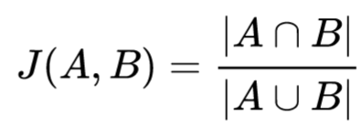
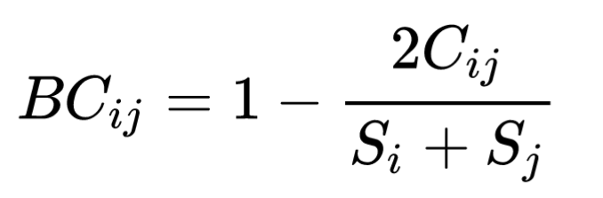
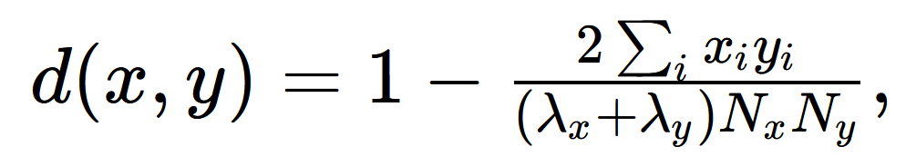
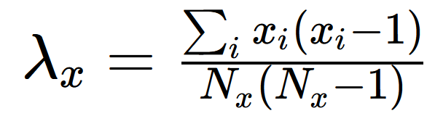
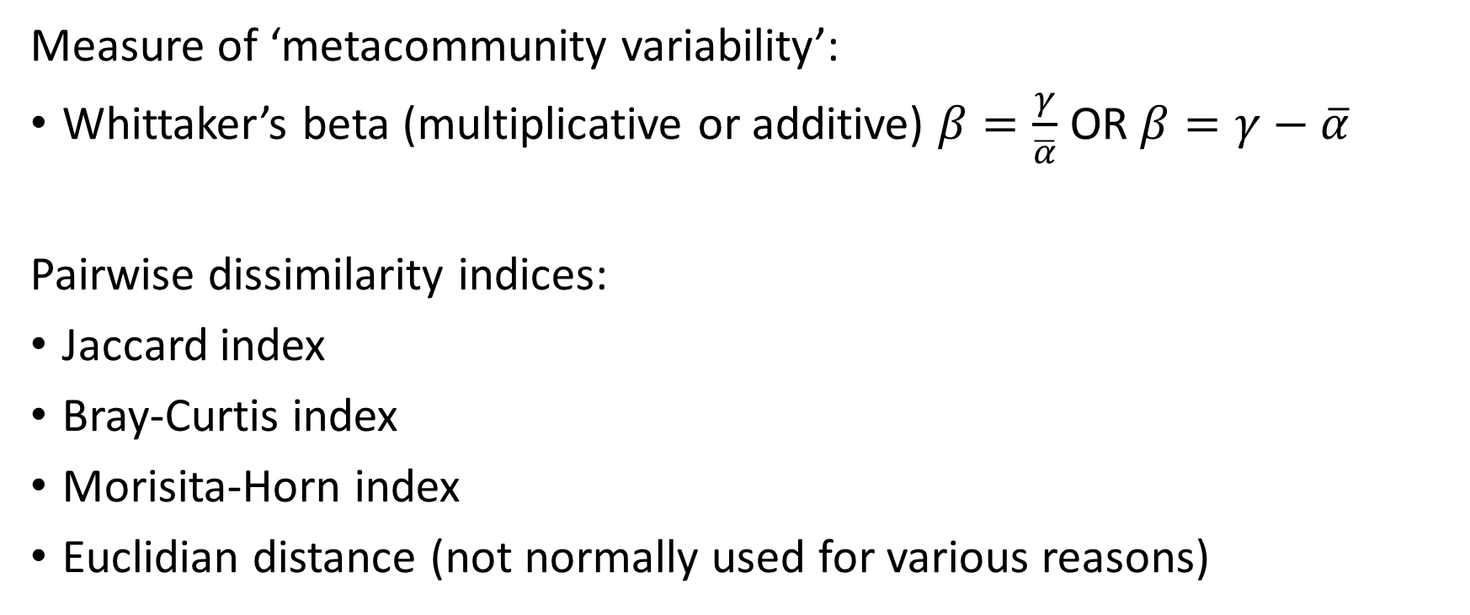
Important beta-diversity metrics
Measure of ‘metacommunity variability’:
Whittaker’s beta (multiplicative or additive) $β=\frac{γ}{\overline{α}}$ OR $β=γ−\overline{α}$
Pairwise dissimilarity indices:
Jaccard index
Bray-Curtis index
Morisita-Horn index
Euclidian distance (not normally used for various reasons)

Slide 25
Relations between metrics
Hill number (q= ) | Alpha scale | Beta diversity
0 | Species richness | Jaccard
1 | exp(Shannon)
2 | 1/Simpson | Morisita-Horn

Slide 26
Exercise
Find beta-diversity indices online, and r packages that can calculate them
Calculate beta-diversity for our generated data

Slide 27
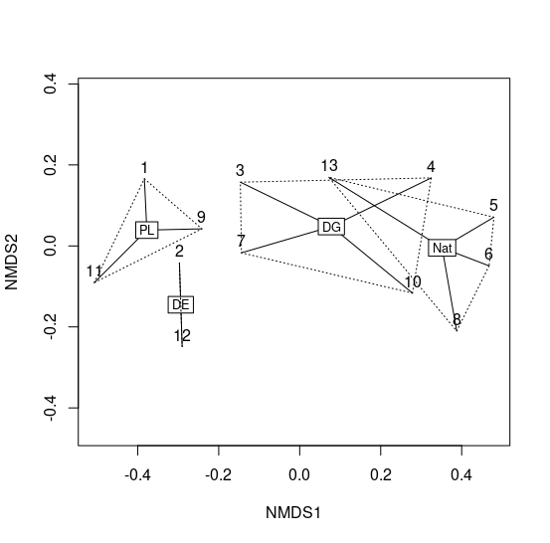
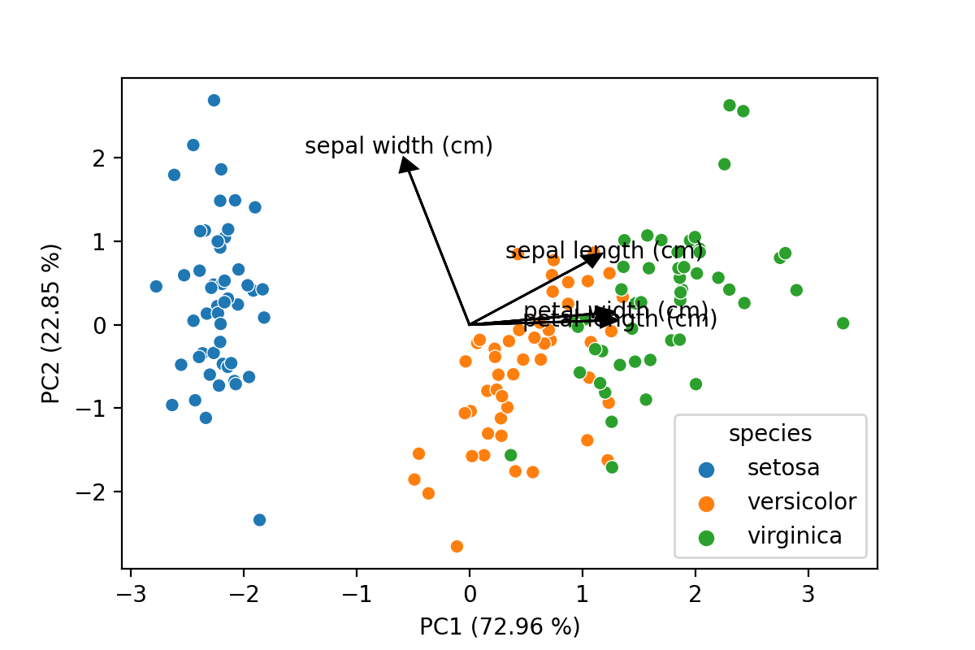
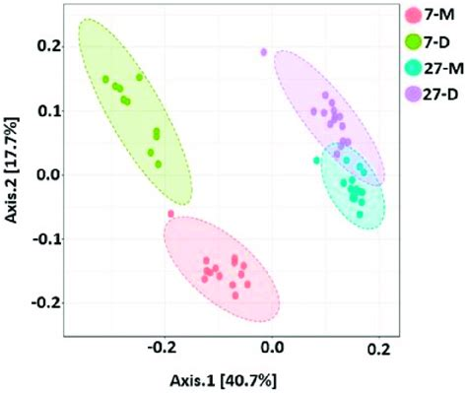
Visualising dissimilarity: multivariate statistics
Dissimilarity matrix:
Ordination:
abundDataNormal abundDataNB
abundDataNB 0.8812829
abundDataPois 0.3954984 0.8806900

Slide 28
Ordination
PCA
PCA (principal component analysis) – for normal data
PCOA (Principal coordinate analysis)
DCA (Detrended correspondence analysis)
NMDS (Non-metric multidimensional scaling)
CA (Correspondence analysis)
CCA (Canonical correspondence analysis)
…
PCOA
NMDS

Slide 29
Wrap up
You have learned:
How to calculate and compare biodiversity using different metrics
What Hill numbers are
What beta diversity is and how to calculate it
What multivariate statistics are and how they can be used to interpret beta-diversity

Slide 30
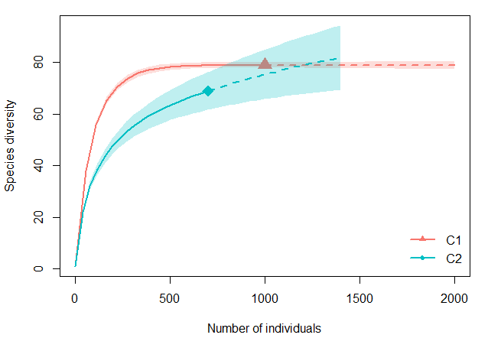
Comparing accumulation curves

